Slide 1
Evaluating A* on NxN sliding block puzzle
Team Pls Don’t Fail Me
Kiely Moore

Slide 2
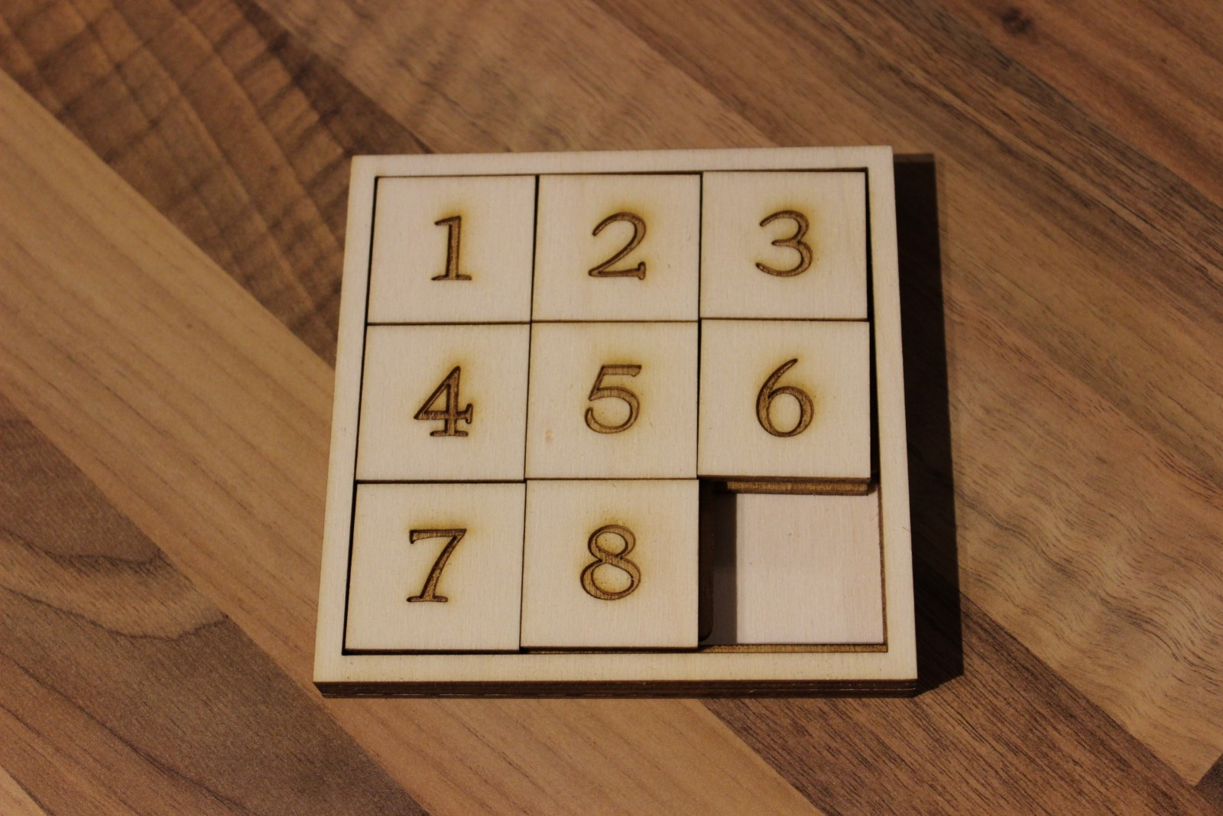
The Problem
The N x N sliding block puzzle is a toy made for children that computer scientists could help but ruining
N is number of tiles that fill a row or column in the puzzle which has (N*N) - 1 tiles.
The goal is to slide tiles around to get them in order like pictured on the right.

Slide 3
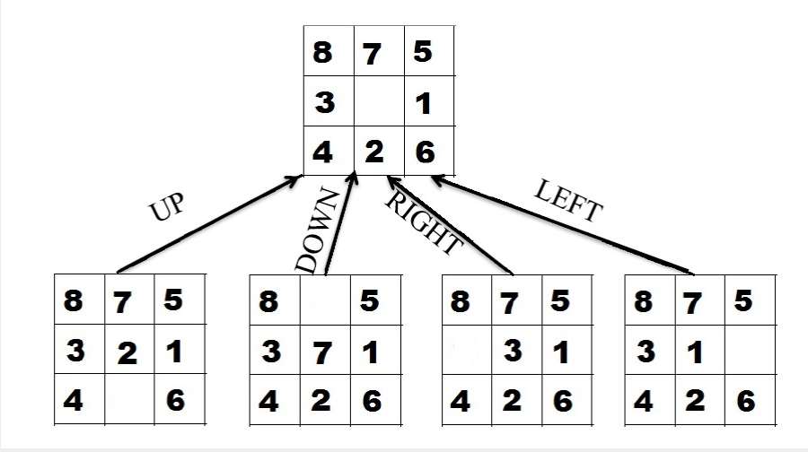
Breaking the Problem down
Given a configuration of tiles, multiple new configurations can be made from it by moving a tile into the empty square.
For our purposes its better to imaging that we are moving the blank ‘tile’ around, swapping it with numbered tile

Slide 4
Problem Space.
Johnson & Story* were able to conclude that for all (N*N)! possible configurations of the puzzle, only half of those are solvable.
Leaving a final solution space of (N^2)!/2. Unsolvable solutions aren’t a problem as we will derive all initial conditions from rearranging the solved layout.
* Wm. Woolsey Johnson, & Story, W. E. (1879). Notes on the “15” Puzzle. American Journal of Mathematics, 2(4), 397–404. https://doi.org/10.2307/2369492

Slide 5
How to Solve the Problem
To solve the NxN sliding block problem, an implementation of the A* algorithm was created in Python that is able to accommodate the configurations of the puzzle as states in the algorithm search space.
A blog post* on A* being used for the sliding block puzzle was the inspiration to used this technique. The post lays out how to start an implementation and the intricacies of the problem.
* Dhondiyal, D. (2016, May 3). Implementing A-star(a*) to solve N-Puzzle. Insight into programming algorithms. https://algorithmsinsight.wordpress.com/graph-theory-2/a-star-in-general/implementing-a-star-to-solve-n-puzzle/

Slide 6
The Algorithm
A* (A Star) is an informed, memory-based search algorithm that is widely used to efficiently find the shortest path between two points on a graph. It is a popular maze solve and is sometimes used for pathing in video games.
The informed part refers to the Heuristic score the algorithm applies to evaluate the fitness/ how far away / un-optimal the current solution is.
The memory based part refers to the two lists, open and closed, that the algorithm has to store solution. Open is for states the algorithm can reach but hasn’t yet visited and closed is for states that the algorithm has visited so it doesn't repeat itself.

Slide 7
How does A* evaluate the puzzle.
 |  | X index
 |  | 0 | 1 | 2
Y index | 0 | 1
 | 1 |  |  | 1
 | 2
The algorithm will use the sum of the manhattan distances of all the tiles in the current solution.
The manhattan distance is just the sum of the difference in X index and Y index
The goal solution has an h-score of 0
H Score = |E.x - A.x| + |E.y - A.y|
H Score = |0 - 2| + |0 - 1| = 3
Expected Position:
E
Actual Position:
A

Slide 8
How does A* evaluate the puzzle.
1 | 2 | 3
4 | 5 | 6
7 |  | 8
G-score = n
A* doesn't just use h-score. It also has a g score or ‘generation’ score. This score represents the cost to get to this solution from the previous one.
A* uses this to find the shortest path to the optimal solution. In our case, the g-score of a state will be 1 + the g-score of its parent and initial state will have a g-score of 0.
The g-score and h-score are combined to get f-score, which is the final score used to evaluate a solution. f-score = g-score + h-score.
1 | 2 | 3
4 | 5 | 6
7 | 8
G-score = n+1

Slide 9
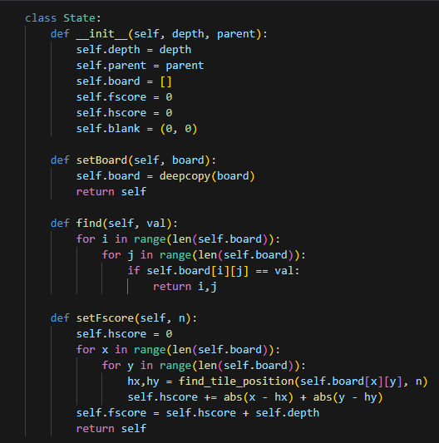
Implementation - State
Class that represents a state in A*
depth = g-score
blank is for easy access to the blank tile. don’t want to search for it.
setFscore implements the heuristic equation to get the f-score of the state.

Slide 10
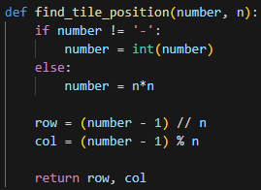
Implementation - Evaluating
Created a simple equation that finds the row and column index of tile when given the tiles number and the size of the board.
This is used to calculate the h-score.

Slide 11
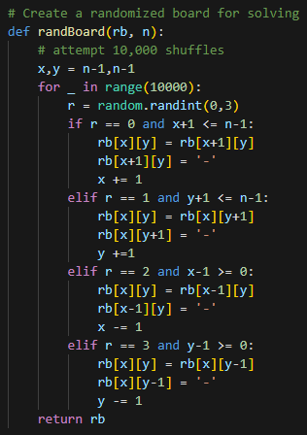
Implementation - Creating Solvable Boards
To avoid unsolvable solutions, randBoard() shuffles the goal solution into a new unsolved one.
Function accepts a deep copy of the goal board and the size of the board.
Attempts 10,000 shuffles to minimize the effects of failing to shuffle the tile off the board and not moving it.

Slide 12
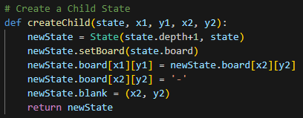
Implementation - Creating New States
Create a new state from a given state with increased depth.
shuffles tile[x1][y1] with tile[x2][y2]
sets the index for the blank tile to avoid needless searching.

Slide 13
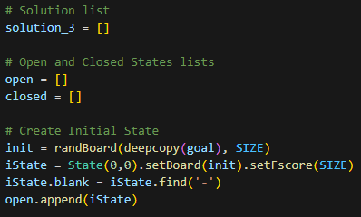
Implementation - A* 3 x 3
Start by initializing the solution list as well as the open and closed lists.
Create a random board to solve.
Create an initial state for the A* solver
The initial state is added for the open list so it will be the first one removed in the solver.

Slide 14
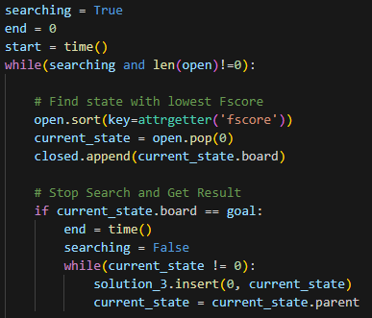
Implementation - A* 3 x 3
Search until a solution is found or no more open states.
Chose the lowest f-score state from the open list and add it to the closed list.
Check the new state to see if the goal has been reached.
If we are at the goal, stop the search and make the solution tree.

Slide 15
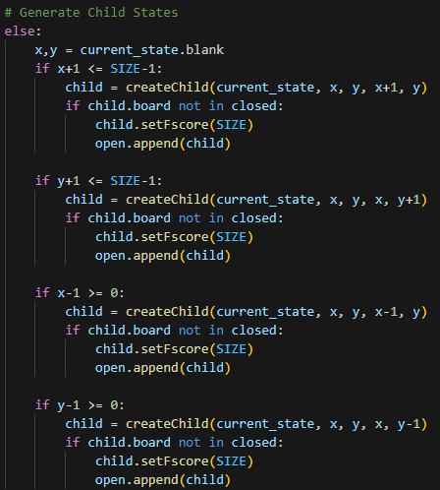
Implementation - A* 3 x 3
If we are not at the goal. Create children from the current state.
Check all four directions a tile could be moved in.
if the tile can be moved make a new board with that change.
If the new board does not belong to a visited state, create a new state and add it to open.
Algorithm repeats, getting a new current state.

Slide 16
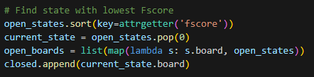
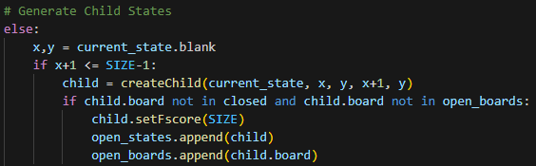
Implementation - A* 4 x 4
4x4 configuration crashed the python kernel, Likely caused by the open list getting to big to handle
new implementation prevents new stated from being created if that board already exists in the open list.

Slide 17

Results - 3 x 3
The averages were collected from 30 different randomly generated test conditions
A solution gets produced in less than a 4th of a second
Solutions can be solved in at most 31 moves. Producing an average length less than that.

Slide 18

Results - 4 x 4
Only tested on one configuration.
Takes hours to solve. extremely slow.
4 x 4 require at most 80 moves to solve.
never got a final solution due to the time to solve.

Slide 19
Conclusions
A* is really good at the 3x3 variant of the problem.
4x4 becomes to complex for A* to solve.
Maybe another heuristic score could remove unfavorable position.
Changing G score? discourage Deep searches or maybe its taking to long searching locally?
What other algorithms can be applied to the problem?
Are any algorithms able to solve problems higher than 3x3?

